Slide 1





DBMS Capstone Project Review-1 2026-27
Bank Account Management System
  Presented by:
26B21AI061 kuppala pavani priya.
26B21AI076 Mutyala navya santhosini
26B21AI098 P S V Subrahmanyam
Guided by:
Mrs G L Narasamba Vanguri
Department : Artificial Intelligence and Machine Learning

Slide 2




Presentation Outline
Introduction
Abstract
Finalize title, objectives & problem statement
Identify entities & attributes
Design ER diagram & relationships
Prepare relational database schema
Define Primary & Foreign Keys
Create GitHub repo & responsibilities
Database creation & constraints
10. Insert sample data
DDL, DML & DQL operations
CRUD operations & SQL queries
Data integrity & validation
Project documentation
Demonstrate & present database
Conclusion

Slide 3



Introduction
What is a Bank Account Management System?
A Bank Account Management System is a database-based application used to store and manage customer and account information for a bank
Why DBMS in Bank System?
Ensures data accuracy and integrity
Supports safe money transfer transactions
Handles many users simultaneously
Reduces data redundancy, duplication
Provides strong security and access control

Slide 4
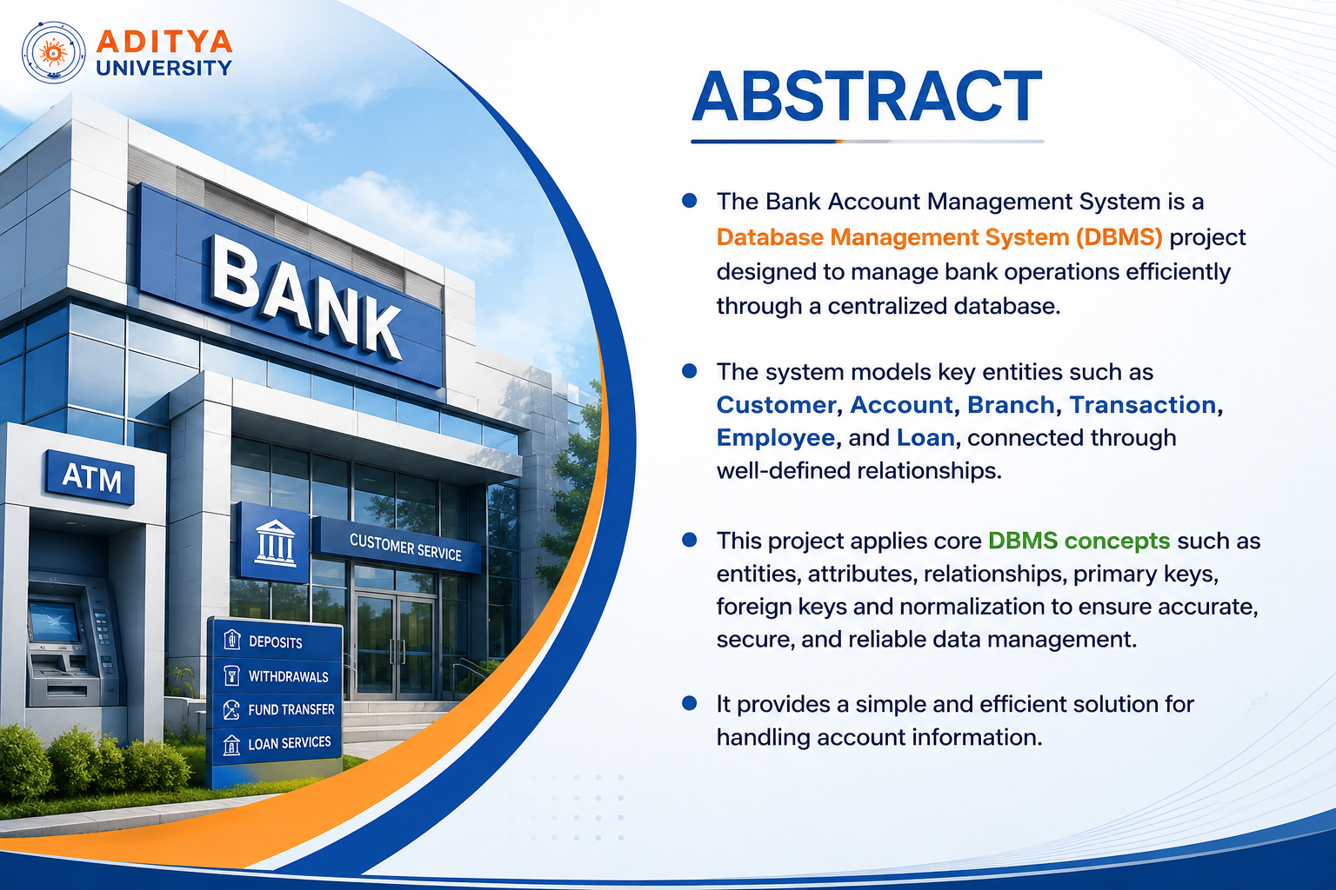


Slide 5
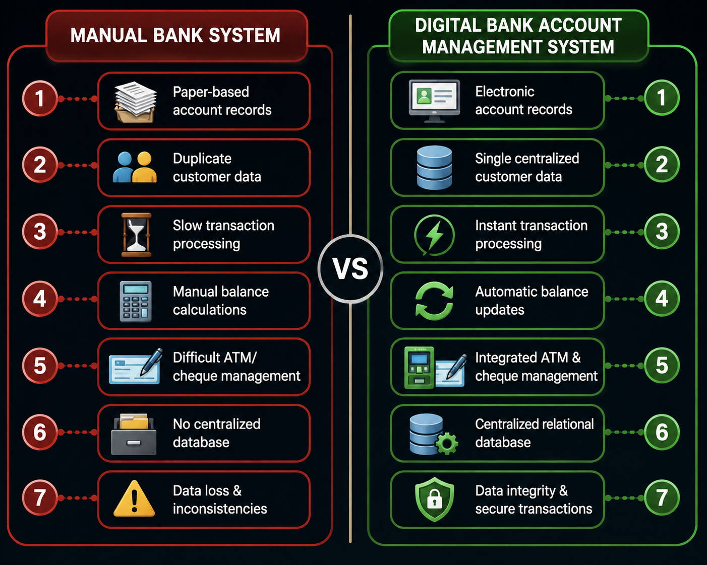

Problem Statement
Manual banking processes introduce critical inefficiencies that compromise transaction accuracy and financial security.
Key Challenges
Paper-based records prone to loss and damage
Duplicate customer entries causing data inconsistency
Slow manual retrieval delaying transaction processing
Billing errors from manual calculations
No centralized database for cross-branch access

Slide 6
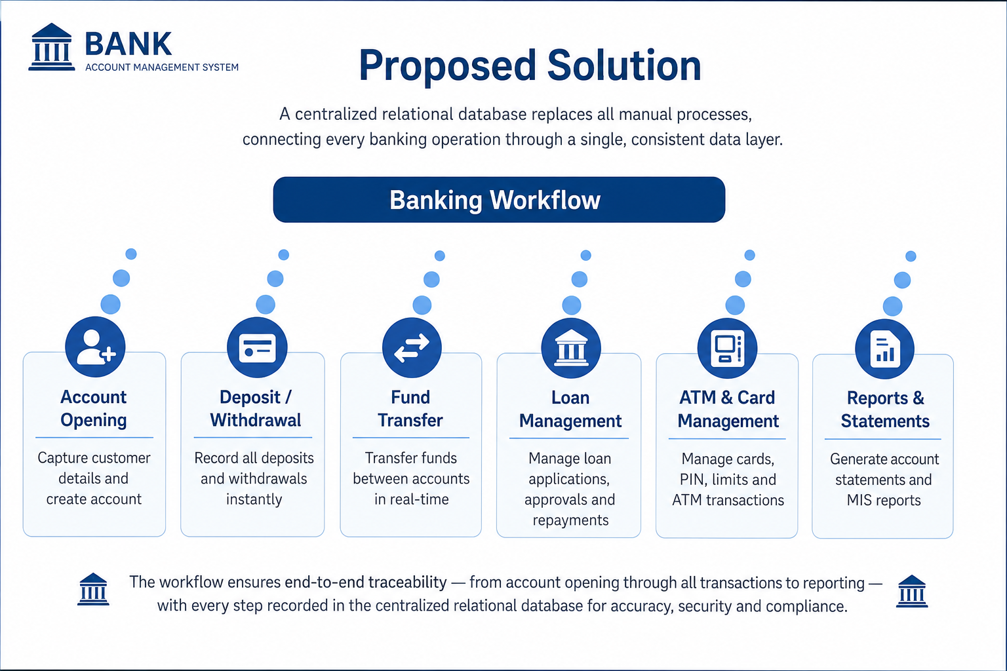




Slide 7
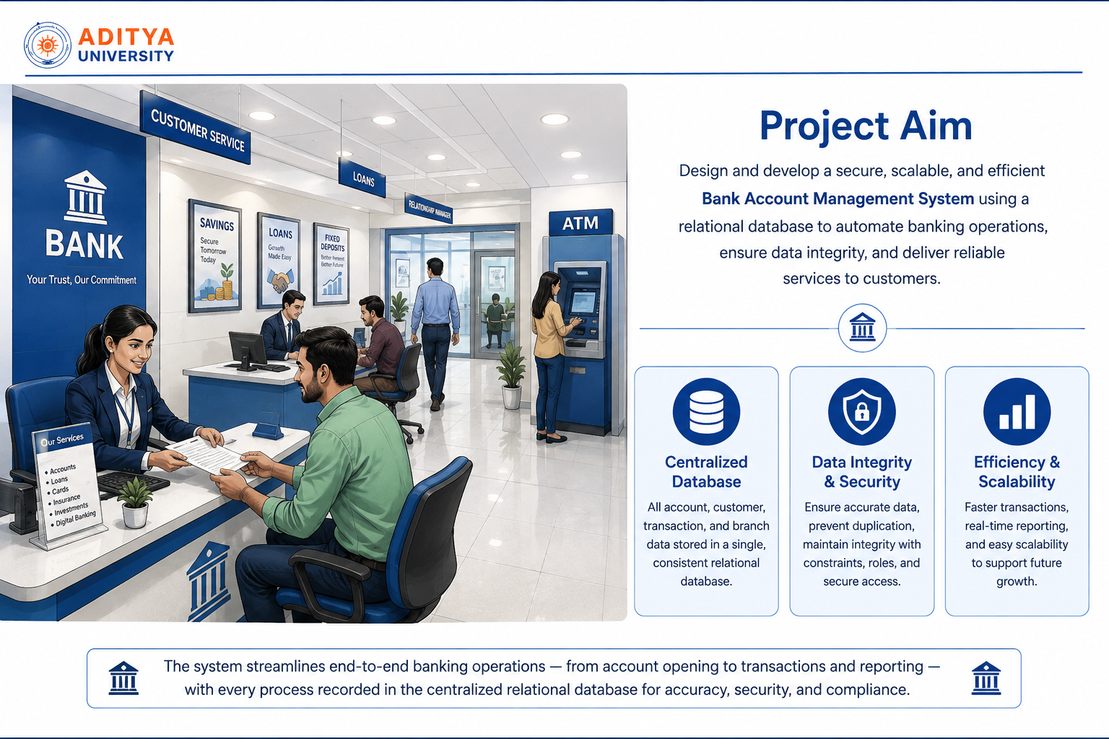

Slide 8

Entities & Attributes
The relational model comprises 10 core entities. Primary Keys (PK) uniquely identify records; Foreign Keys (FK) enforce referential integrity across relationships.
Entity
Primary Key
Key Foreign Keys
Branch
Branch_ID (PK)
—
Employee
Employee_ID (PK)
branch_ID (FK)​
Customer
Customer_ID(PK)
__
Account
Account_No(PK)
branch_ID (FK)​​
Transaction_Log
Transaction_Log(PK)
account_NO (FK)​
Loan
Loan_ID(PK)
account_NO (FK)​​
Card
card_ID (PK)
account_ID (FK)

Slide 9
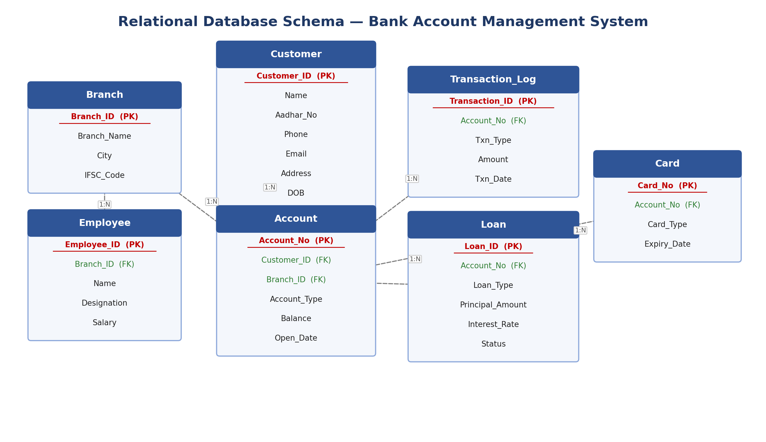





Slide 10
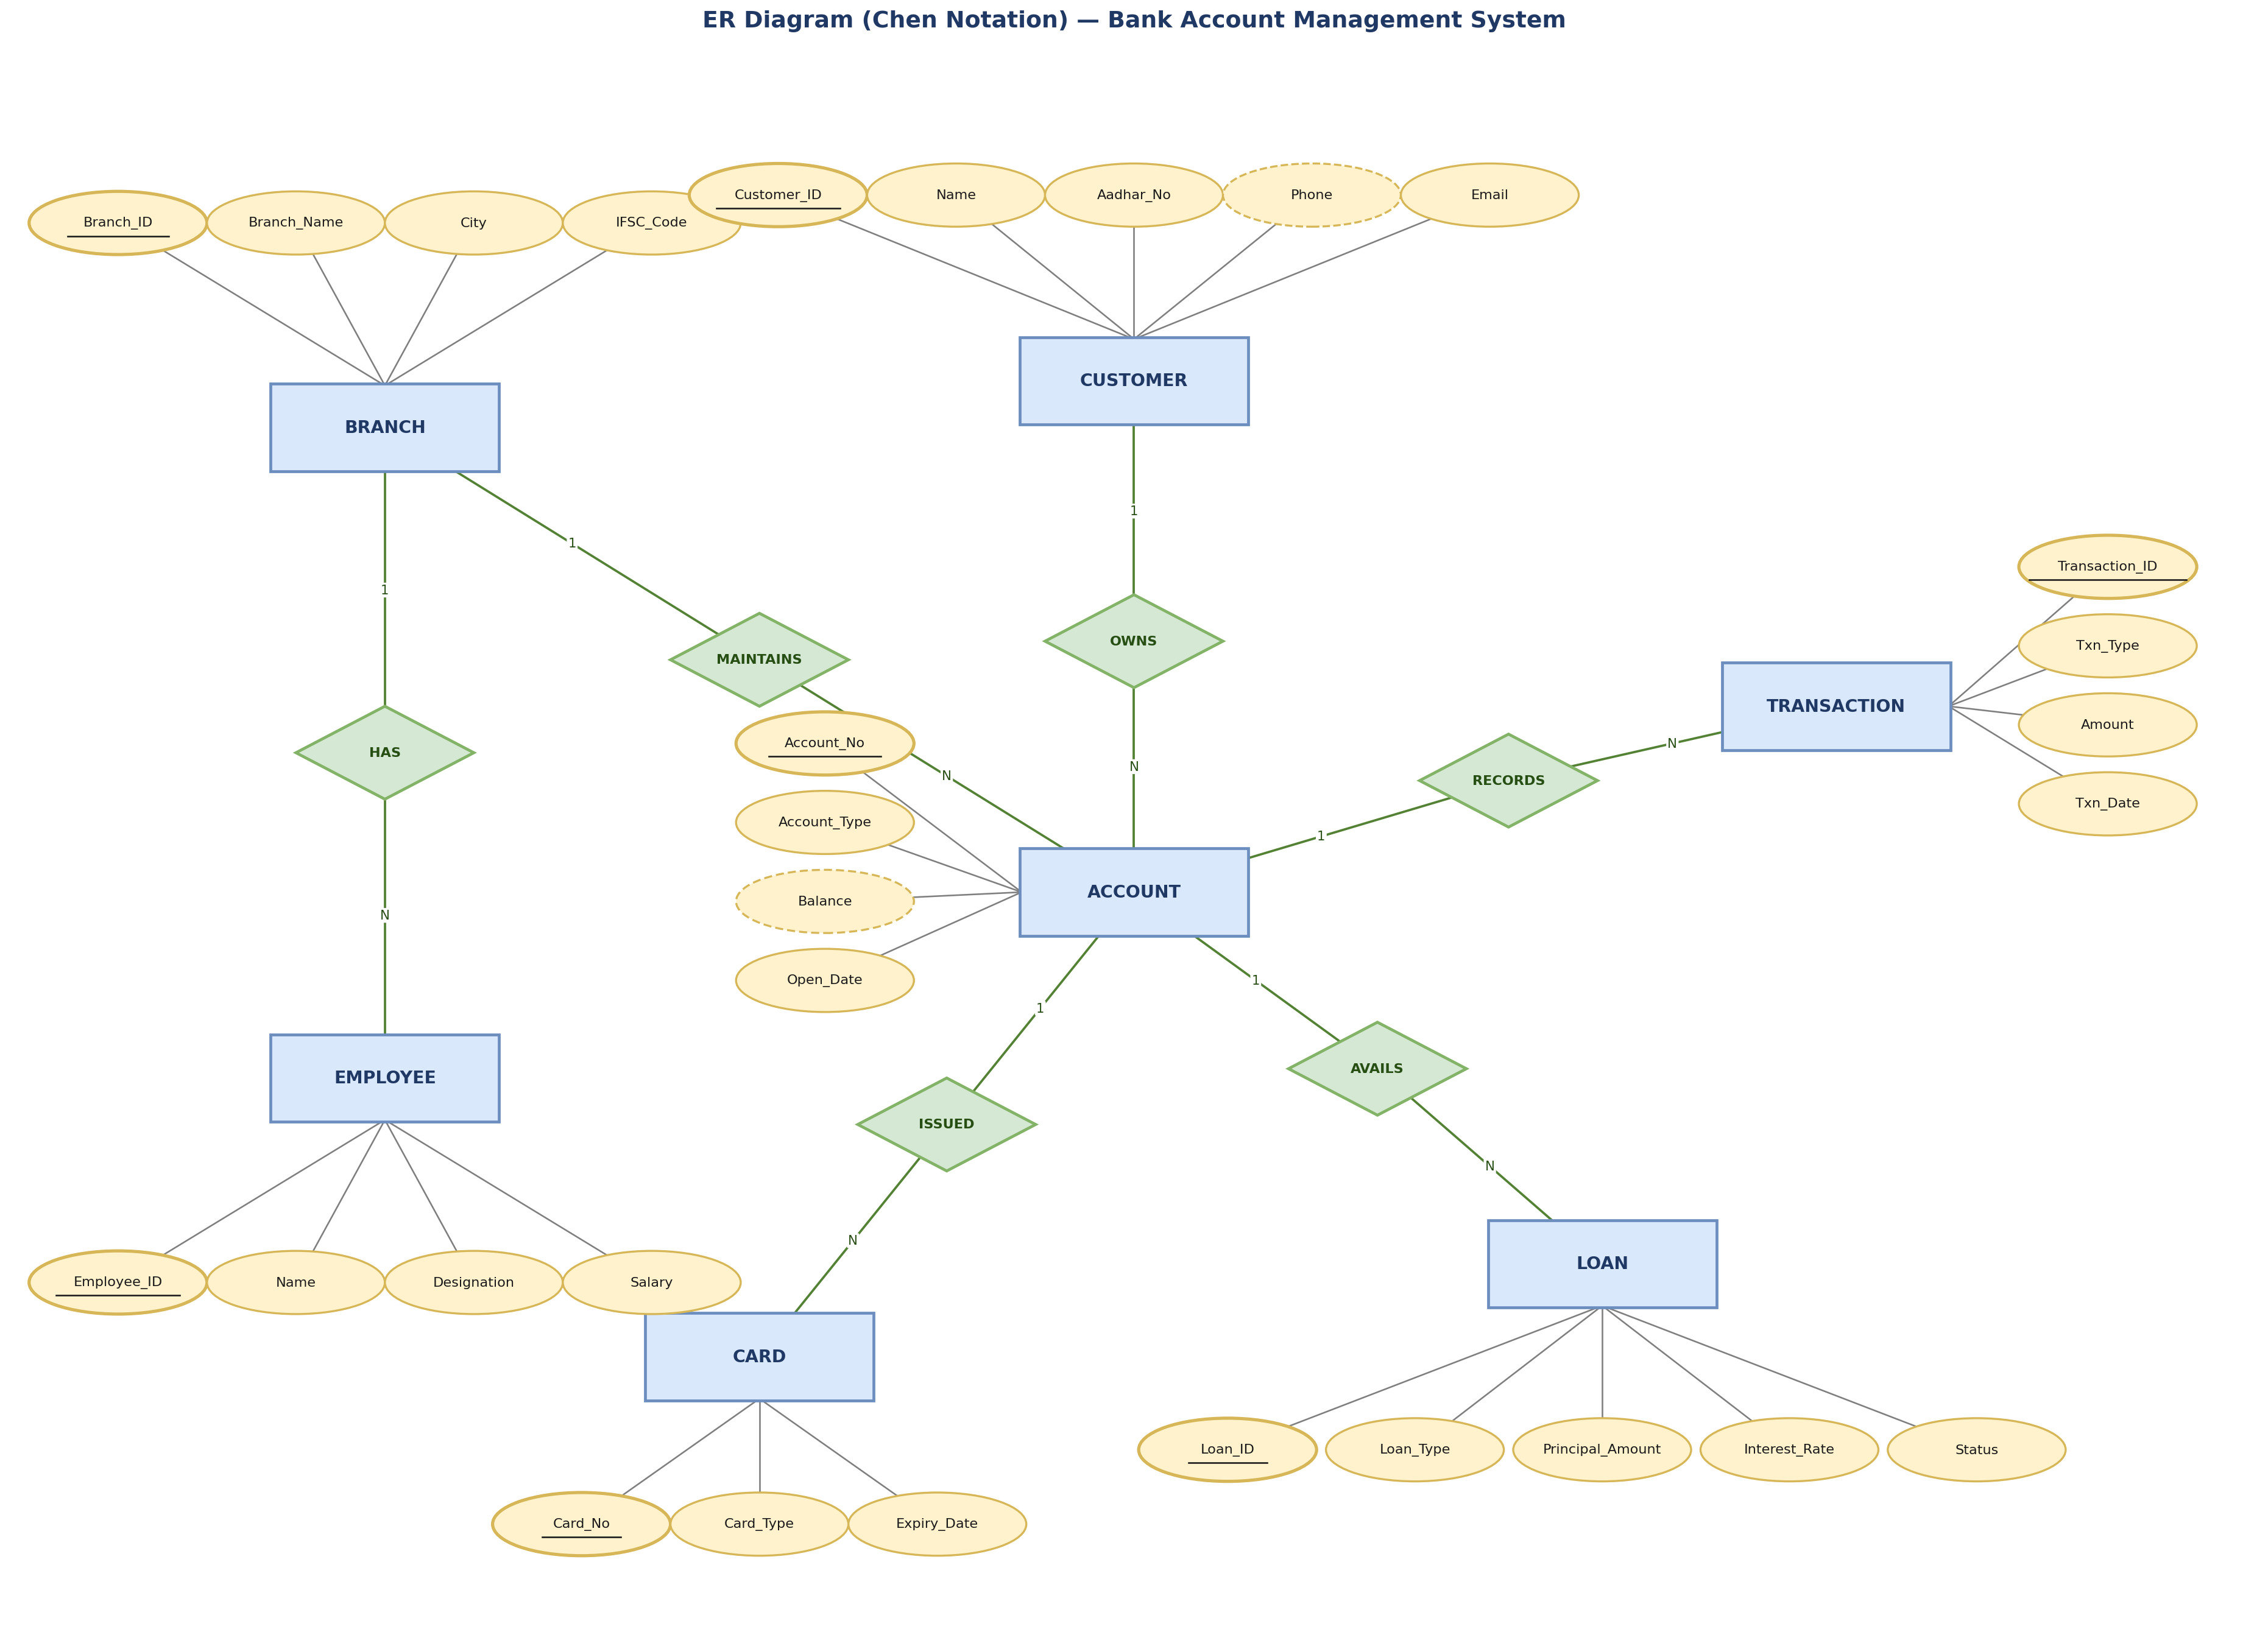





Slide 11
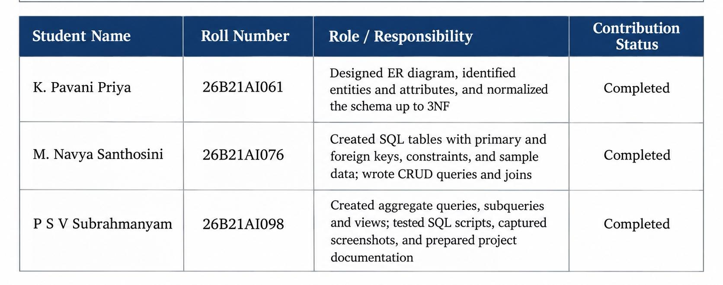
GITHUB REPOSITORY & TEAM RESPONSIBILITIES
Repository Link: https://github.com/pavanipriyakuppala-source/team-19-BANK-ACCOUNT-MANAGEMENT-SYSTEM

Slide 12
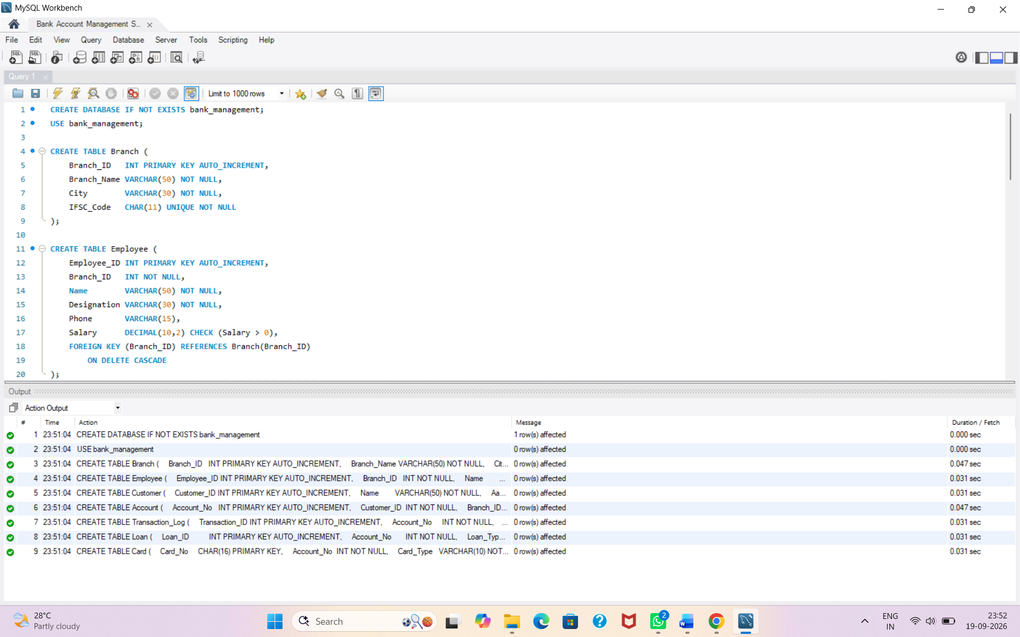
Database creation & constraints

Slide 13
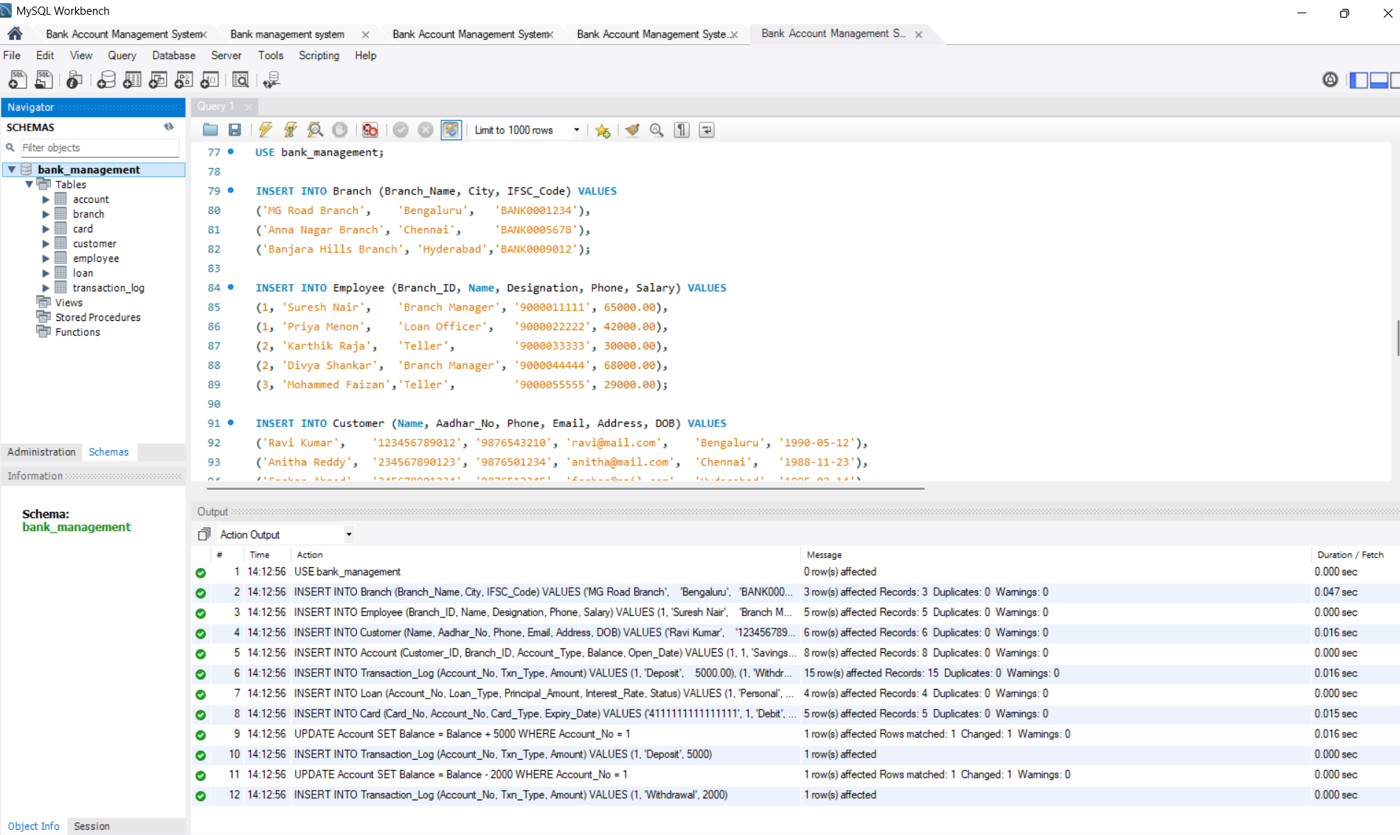
Insert sample data

Slide 14
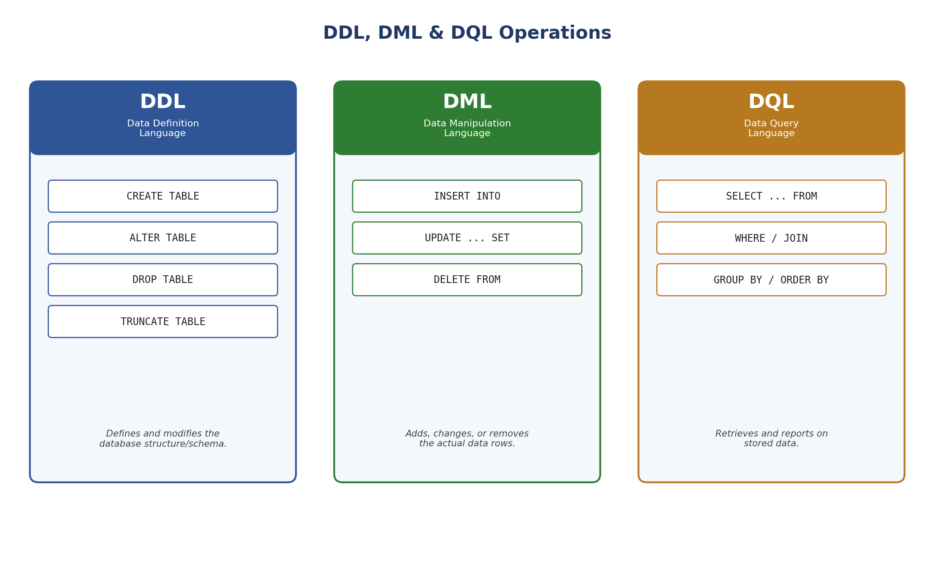

Slide 15
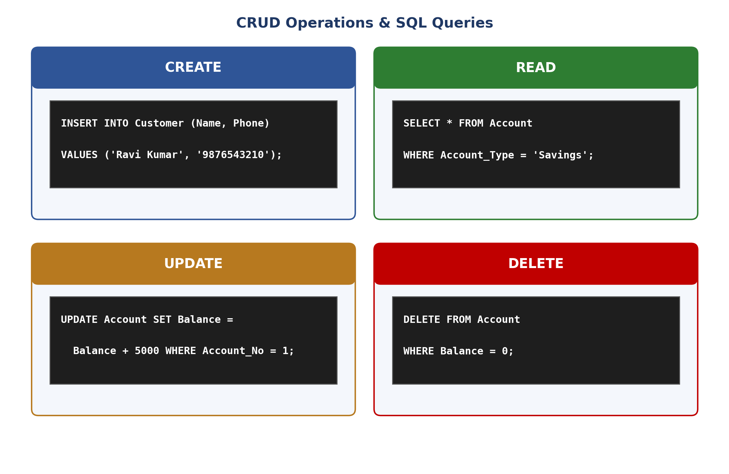

Slide 16
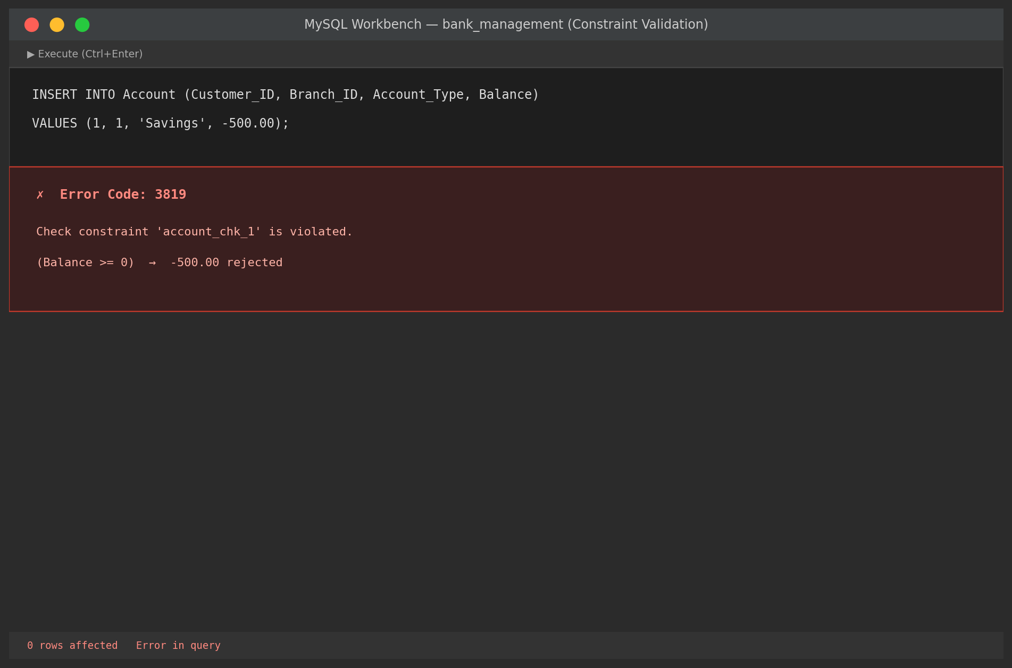
Data integrity & validation

Slide 17
Project documentation
Link: Click here for Project documentation

Slide 18





Technologies Required
MySQL & SQL
Relational database engine and query language
MySQL Workbench
Schema design, visualization, and administration
Draw.io
ER diagrams, system flowcharts and also for database architecture
Microsoft PowerPoint
Project documentation and review presentation

Slide 19
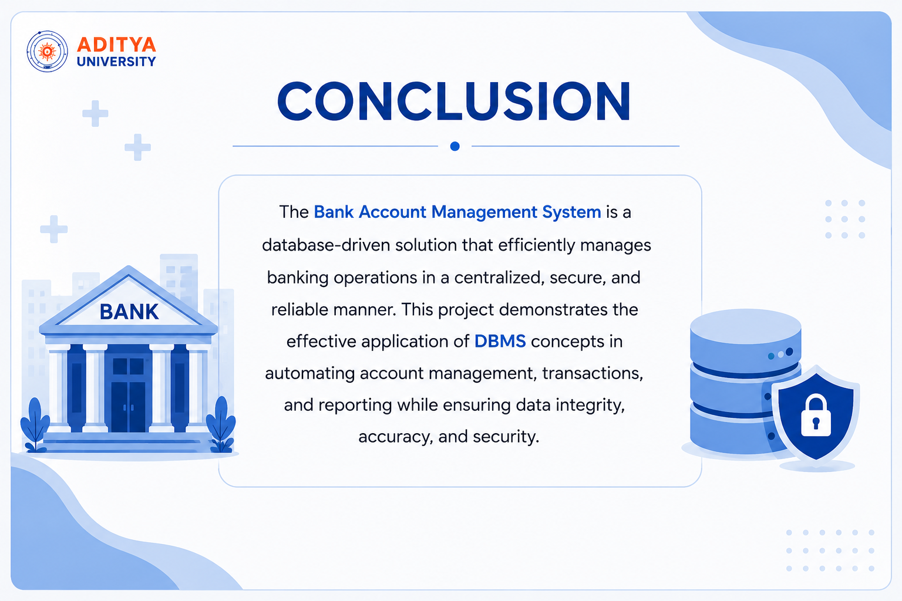

Slide 20


